Slide 1

Deep Learning Painters By Numbers Project
Course staff – Prof.Rita Osadchy , Amit Shahar
Noor Abo El Foul – 206692170

Slide 2
introduction
Problem :
The problem is to determine that given paintings are drawn by the same artist or not.
We use the skills and the appropriate tools that we have learned through the semester to solve this problem.
We will discuss the solution and the steps that we used in order to solve this problem in the following slides.

Slide 3
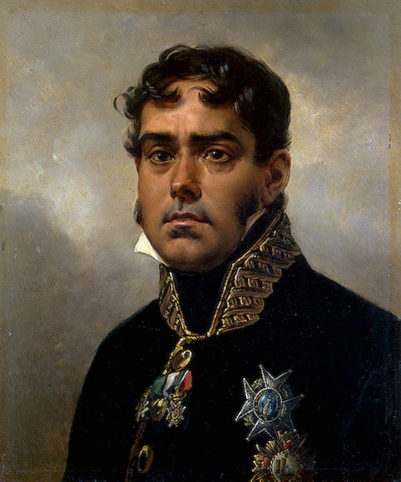
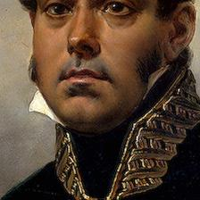
Step 1 : pre-processing the data
We applied center crop with size 224x224 to prepare it to be an input for our Siamese network that include the pre trained Resnet18.
Example: (Portrait of General Pablo Morillo by Horace Vernet):

Slide 4
Step 2 : pre-processing the data ||
For training and validation data we used 17,997 different images, that belongs to 1,208 different artists, we divide it such that 772 different artists in the training set and 190 different artists for the validation set (we get rid of the artists that have less than 2 images).
For test data, we used 2936 images that belongs to 91 unique artists (all the artists that have at least 2 paints).
In train, validation and test we make sure that the artists are completely different.

Slide 5
Step 3 : data size
From the data we took 10 images for each artist, (if an artist has less than 10 images then we took them all) after that, we generated 30,000 triple (anchor, positive, negative) randomly for the training, we generate the 30,000 triples each epoch in order to prevent Overfitting and train the model on bigger data, we generate 6,000 (20% of 30,000) triple randomly for the validation and test each.

Slide 6
Step 4 : Network Architecture
The architecture of the Siamese Network that we used consists of a pre-trained ResNet-18 model with the last two layers (average pooling and fully connected layer) removed, followed by a dropout layer with a dropout rate of 0.25, a fully connected layer with 256 output features, another dropout layer with a dropout rate of 0.30, and finally a fully connected layer with 64 output features.

Slide 7
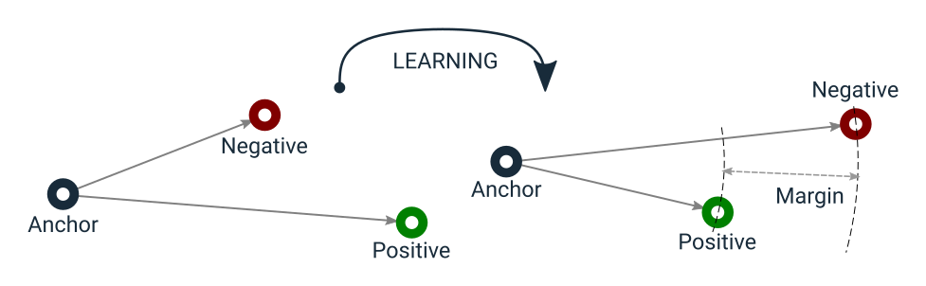
Step 5 : Loss Function
Loss Function: Triplet Loss, the goal of triplet loss is to minimize the distance between the anchor and the positive images while raising the gap between the anchor and the negative images.

Slide 8
Step 6 : Reduce Overfitting
In order to reduce overfitting we applied random transformation (RandomRotation, RandomFlip, Normalization ,…) in the training processes, even though this reduced the accuracy of the train, this is also helped the model to generalize better to unseen data.

Slide 9
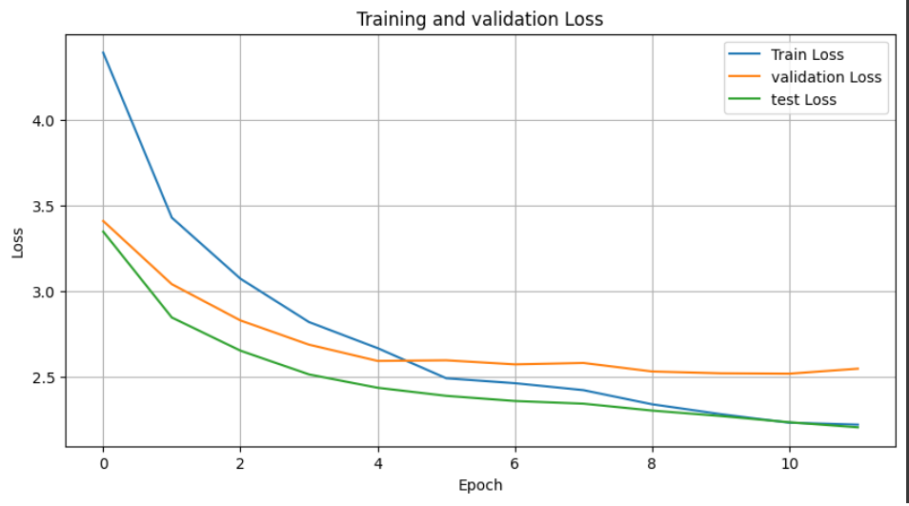
Results : Loss plot

Slide 10
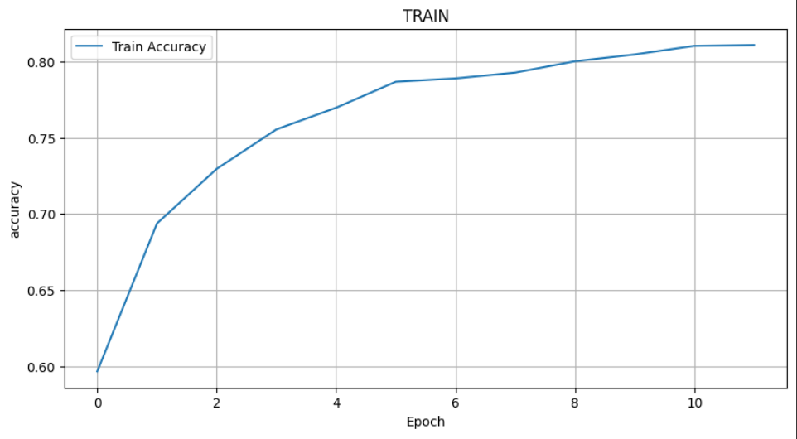
Results : Accuracy plot

Slide 11
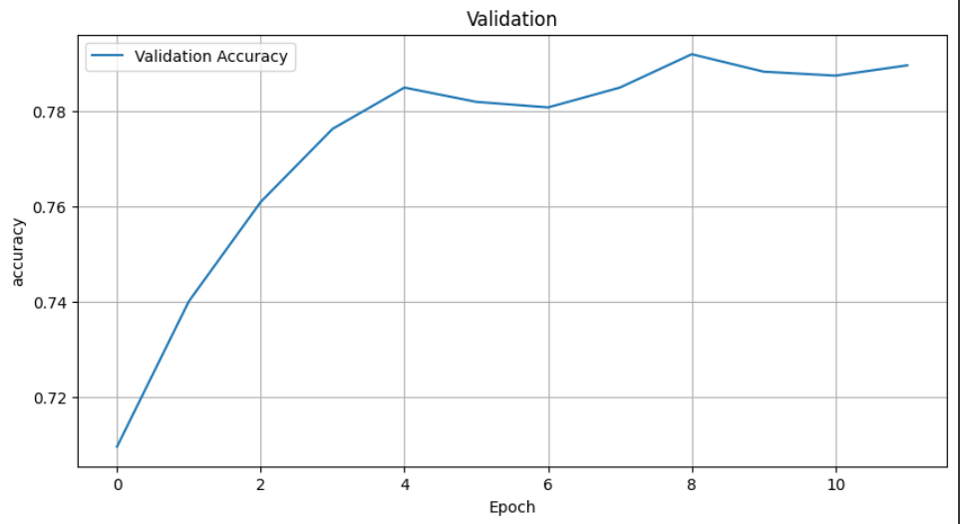

Slide 12
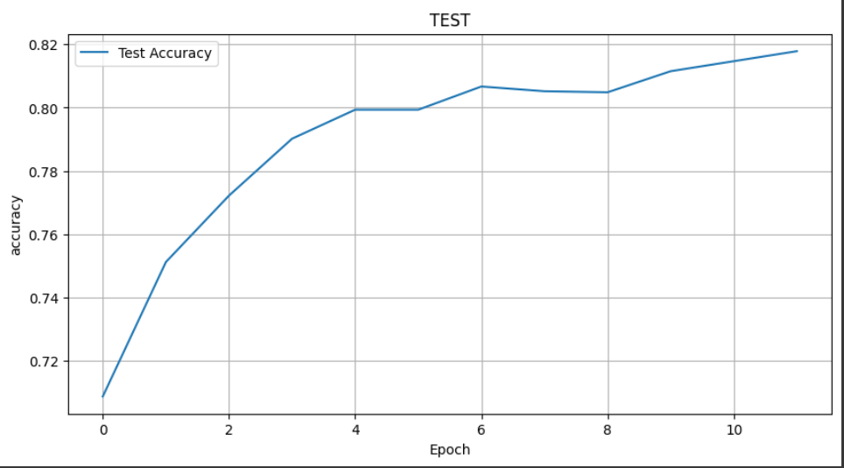
Test Accuracy: We reach to test accuracy: 81.7833%.

